Slide 1
BIG DATA
BUAN 6346.501
Professor Austin Henslee
Group 2:
Fateh Ahmad
Phuong Ngan Bui
Ravi Dawar
Anusha Rao Tatavarti
Udita Dasgupta

Slide 2
Unemployment & Poverty analysis
Group 2

Slide 3
Dataset Overview
Datasets Used:
Unemployment Data from The Bureau of Labor Statistics Local Area Unemployment Statistics program. This dataset comprises of county and State unemployment rates. 3275 rows, 52 columns
Poverty data from the U.S. central bureau. This dataset contains small area income and poverty estimates (SAIPE) and comprises of 3194 rows, 34 columns
We merged both the datasets into one for our analysis.

Slide 4
DATA SOURCES
Listed below are the dataset which comprises of unemployment and poverty rate of all US State and
County. Dataset is obtained via the following source link
SOURCE https://www.ers.usda.gov/data-products/county-level-data-sets/download-data/
PRIMARY DATASET
Unemployment (Unemployment.xlsx)
Dataset comprises of county and State unemployment rates obtained via Bureau of Labor Statistics (BLS)
Local Area Unemployment Statistics (LAUS) program. Median household is from the U.S. Census
Bureau's. Small Area Income and Poverty Estimate (SAIPE) program.
Metadata – 3275 rows, 52 columns
Poverty (PovertyEstimates.xlsx)
Dataset comprises of poverty estimates of US state and county obtained via U.S. central
bureau and model based. Small area income and poverty estimates (SAIPE).
Metadata – 3194 rows, 34 columns

Slide 5
DATA MODIFICATION
Data Cleansing:
We omitted blank rows and columns in both the dataset.
Data Manipulation:
In Unemployment and Poverty dataset, we are taking data provided for the year 2016 and dropping
other. On defining the range of features to be consider, we merged the dataset naming it as
“Unemployment Povety_2016 “dataset. Metadata – 3141 rows, 12 columns
Below are the important fields in each of our data set and its description
Variable | Description
FIPStxt | State-County FIPS Code
State | State Abbreviation
Area_name | State or County name
Metro_2013 | Metro nonmetro dummy 0=Nonmetro 1=Metro (Based on 2013 OMB Metropolitan Area delineation)
Civilian_labor_force_2016 | Civilian labor force annual average, 2016
Employed_2016 | Number employed annual average, 2016
Unemployed_2016 | Number unemployed annual average, 2016
Unemployment_rate_2016 | Unemployment rate, 2016
Median_Household_Income_2016 | Estimate of Median Household Income, 2016
POVALL_2016 | Estimate of people of all ages in poverty 2016
CI90LBAll_2016 | 90% confidence interval lower bound of estimate of people of all ages in poverty 2016
CI90UBALL_2016 | 90% confidence interval upper bound of estimate of people of all ages in poverty 2016

Slide 6
Why this dataset
We believe that these datasets would provide us with the most accurate data for our analysis since they come from federal entities.
Our dataset would help us determine the unbiased relationship between unemployment and poverty.

Slide 7
Analytics techniques
Linear Regression
Simple Cross Validation
Linear Stochastic Gradient Descent
Principal Component Analysis
Logistic Regression
Kmeans Clustering

Slide 8
Linear Regression
Linear regression will be used to capture the interaction that the variables have with our target variable(poverty).
We will be preplanning for this analysis by ensuring that there isn’t collinearity between variables in our model.
Linear regression will be carried out using Spark.

Slide 9
Simple Cross Validation
We will be separating the data into training and testing data to ensure that the models that we run are accurate and we are able to avoid overfitting.
Pre-planning on our part will primarily be deciding the ratio to separate our data. For our analysis, we will be using the ratio of 90:10.
This analysis will be done using Spark.

Slide 10
Linear Stochastic Gradient Descent
This will help us determine more precise parameters, which will capture the effects of dependent variable with more accuracy.
Preplanning for this process is done by scaling the features.
We will be doing this in Spark.

Slide 11
Principal Component Analysis
This analytic technique will help us reduces the number of variables to a smaller set that contains most of the information in the data. This will be done by capturing the variance between our variables.
We will capture the variances before and after our analysis to ensure accuracy of our model.
This technique will be carried out using Spark.

Slide 12
Logistic Regression
Classify the target variable as Metro and Non Metro based on the independent variables. Also checking the accuracy of the model by simple cross validation.
Preplanning for this analysis will be defining the variable to be used.
Logistic regression analysis will be carried out in Spark.

Slide 13
Kmeans Clustering
Classify all variables as Feature vector.
Preplanning for this analysis will be defining the variable to be used.
Kmeans clustering will be carried out in Spark.

Slide 14
Data Exploration
For Categorical values in Columns
Variable : Variable Name nulls : Null values in column missing values : Missing values in column
distinct values : Null values in column
For Numerical values in Columns
Variable : Variable Name min : Minimum value in column
max : Maximum value in column avg : Average value in column
Nulls : Null values in column missing values : Missing values in column
distinct values : Null values in column

Slide 15
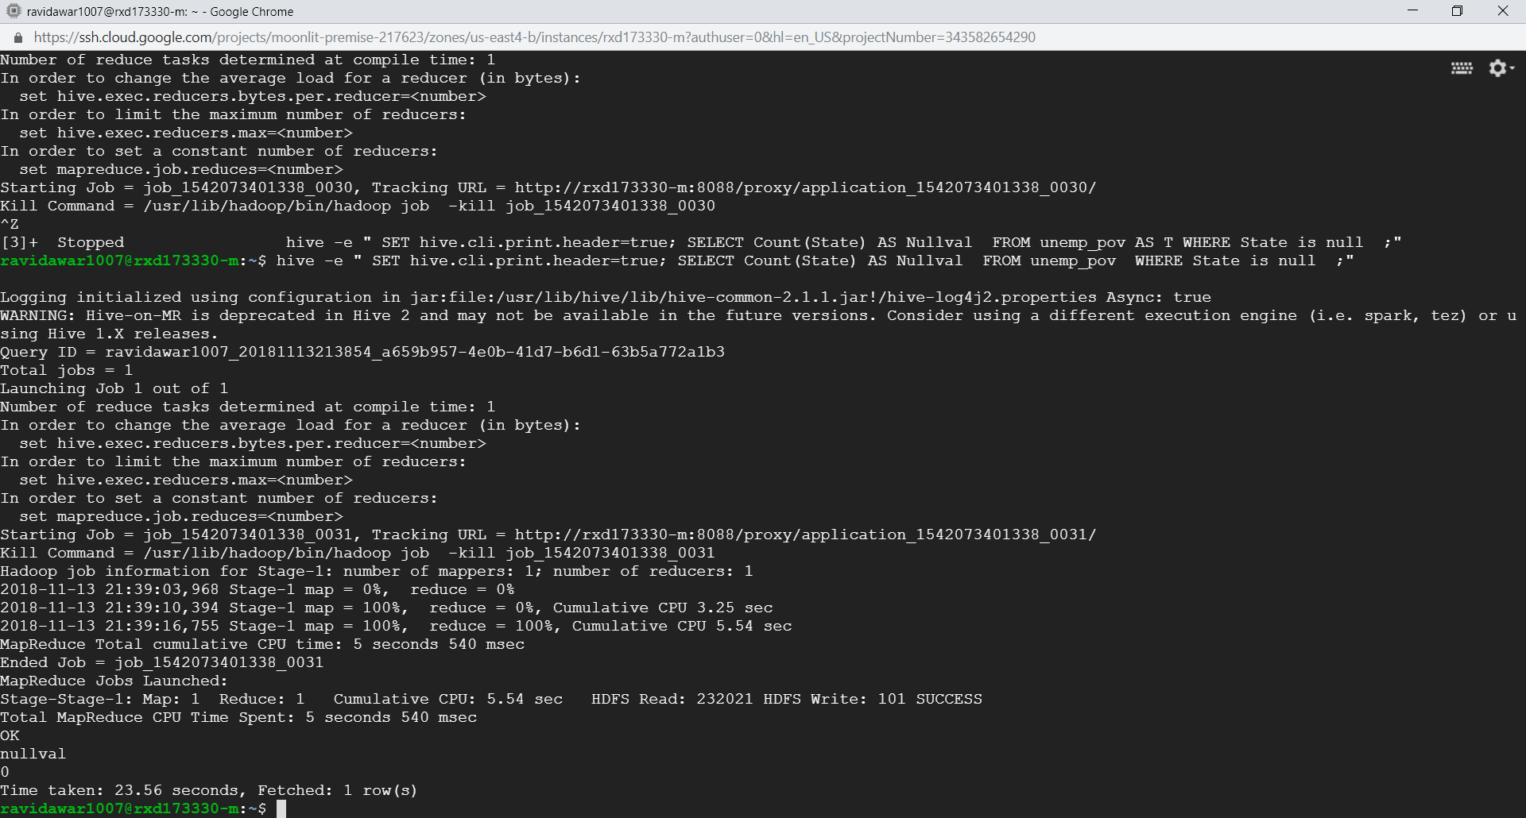
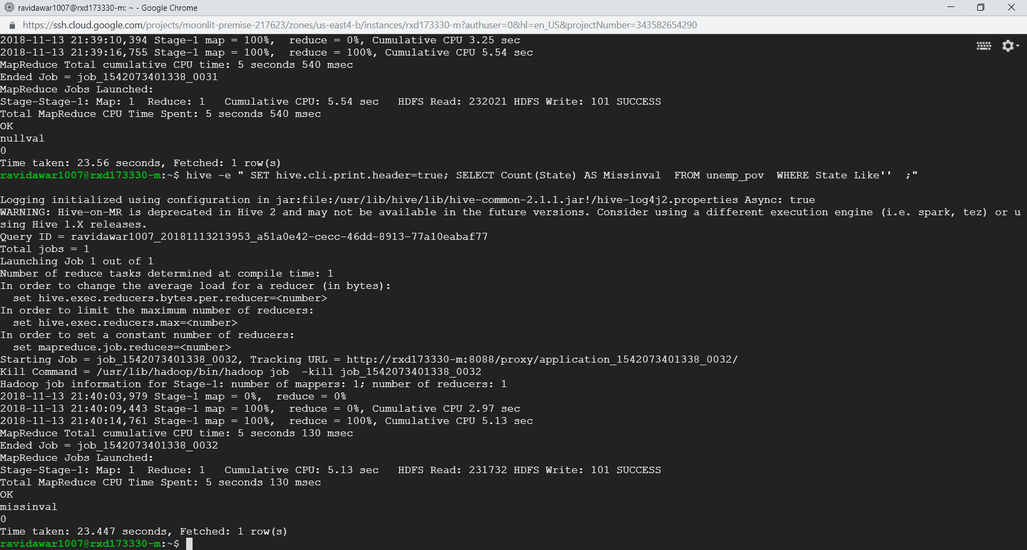

variable: State nulls: 0 missing values: 0
distinct values: 51

Slide 16

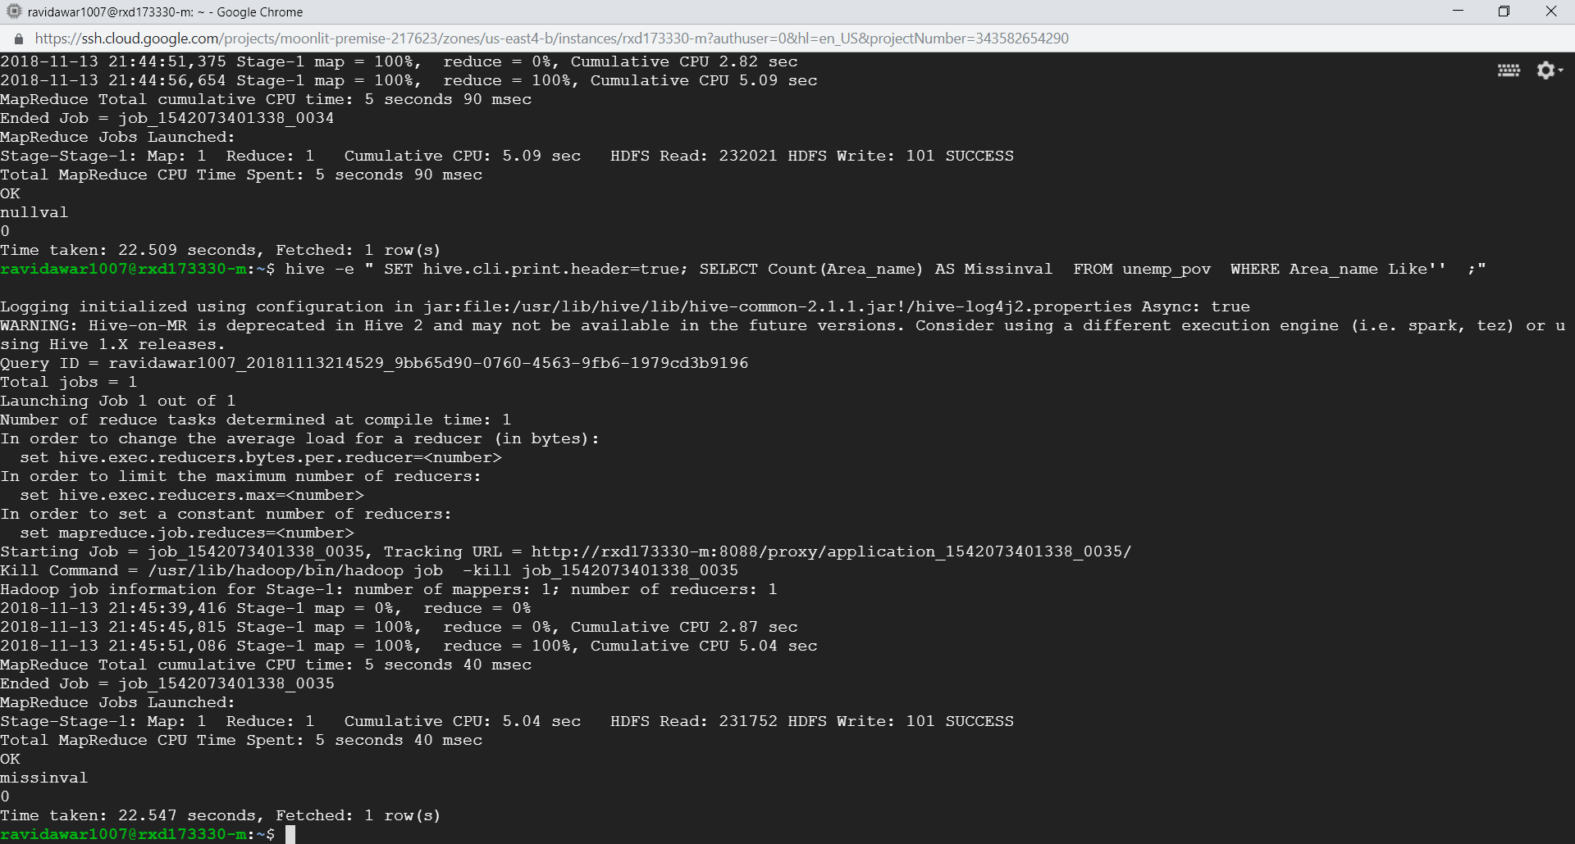
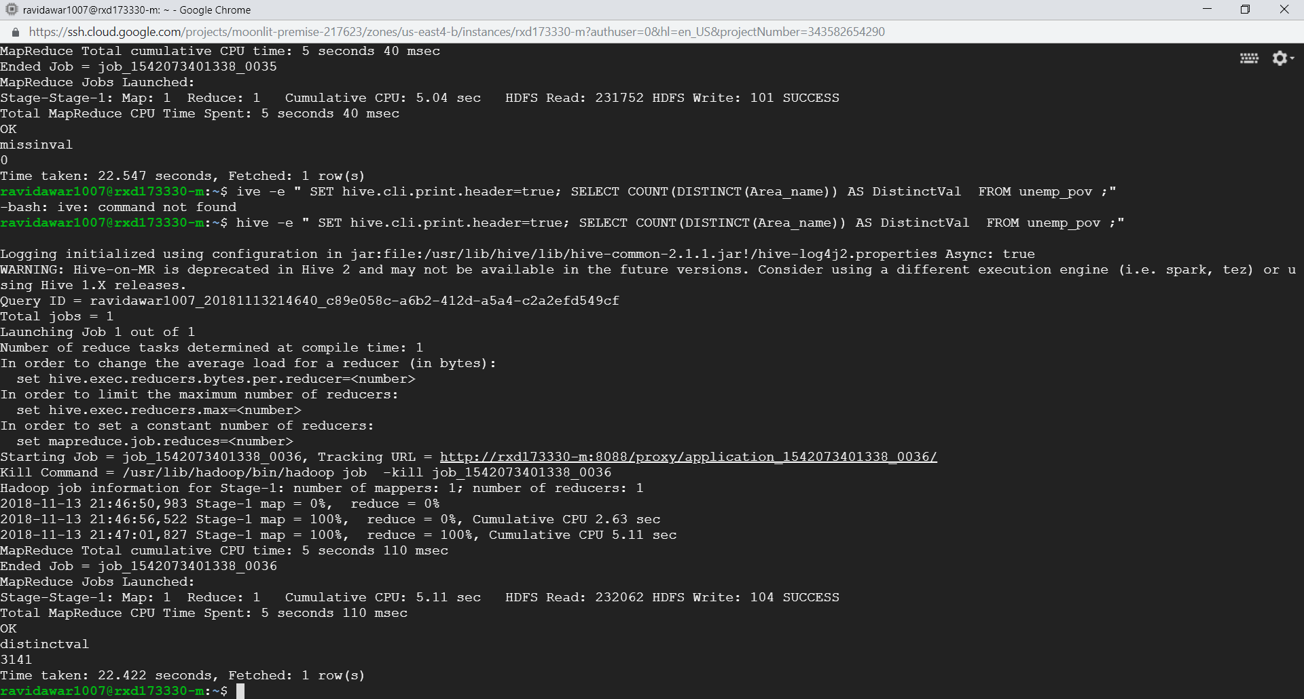
variable: Area_name nulls: 0 missing values: 0
distinct values: 3141

Slide 17



variable: Metro_2013 nulls: 0 missing values: 0
distinct values: 2

Slide 18
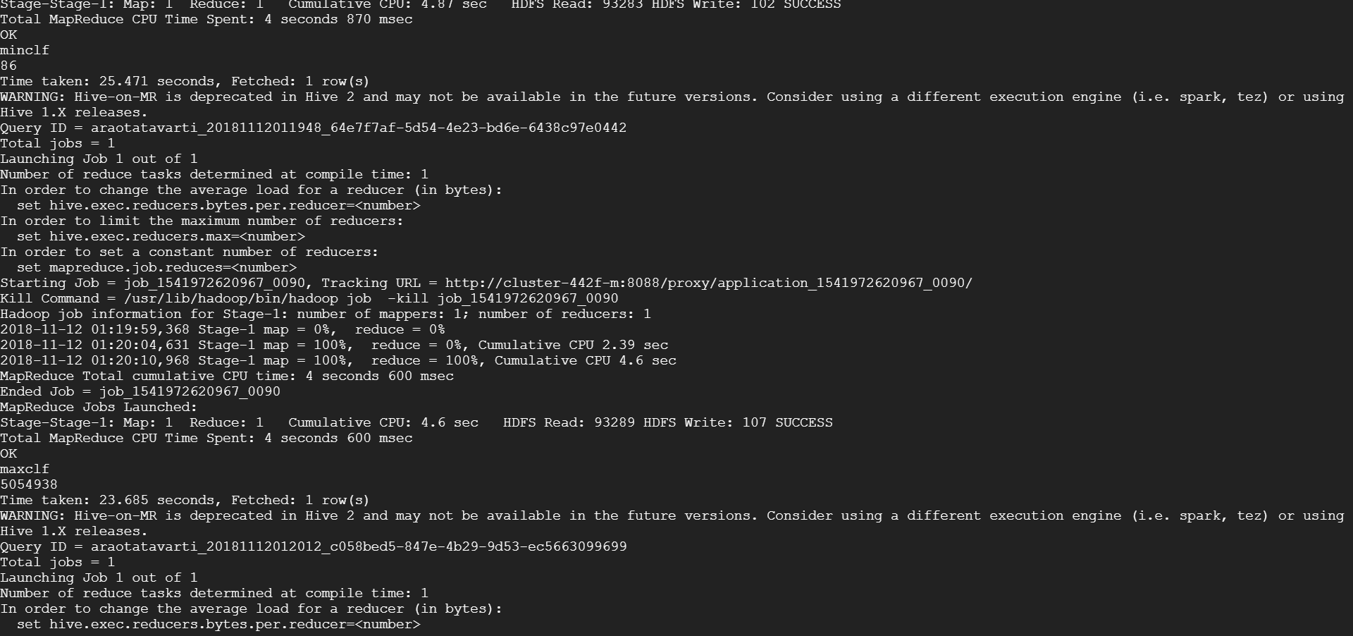
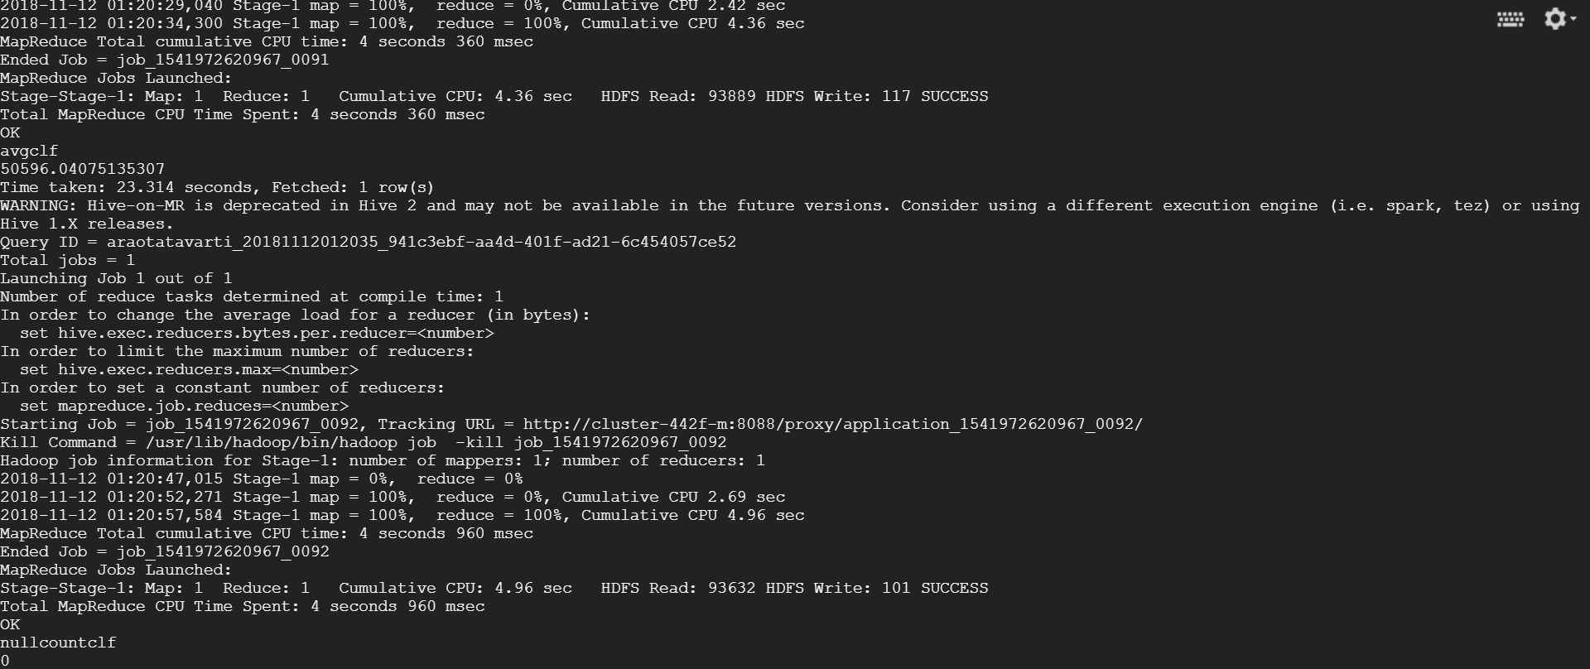
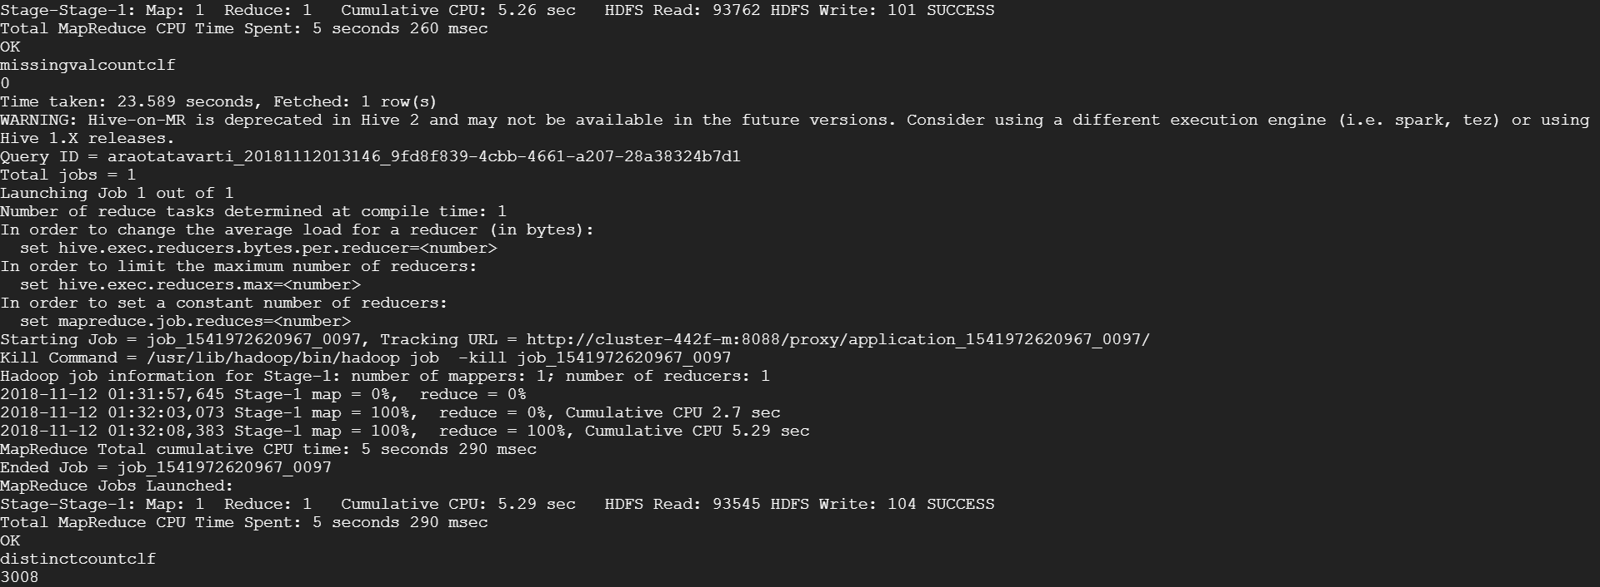
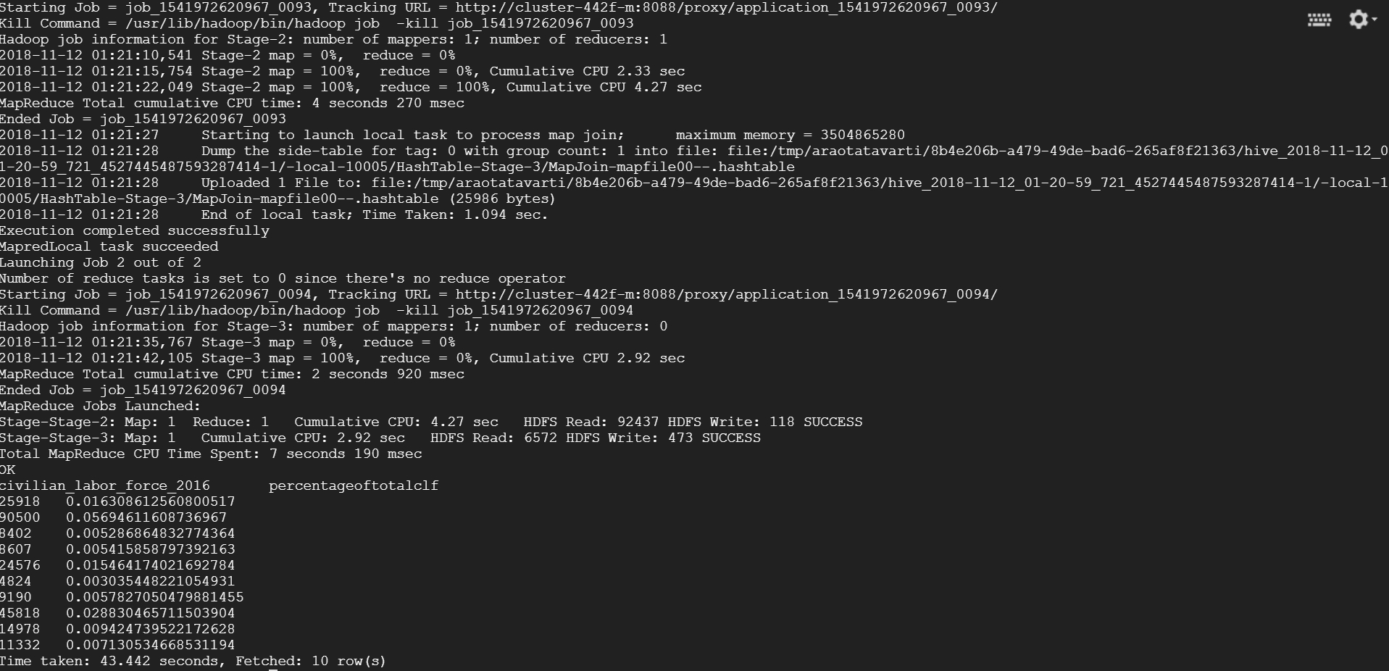
variable: Civilian_labor_force_2016 min: 86 , max: 5054938 avg: 50596.040751, nulls: 0 missing values: 0, distinct values: 3008

Slide 19
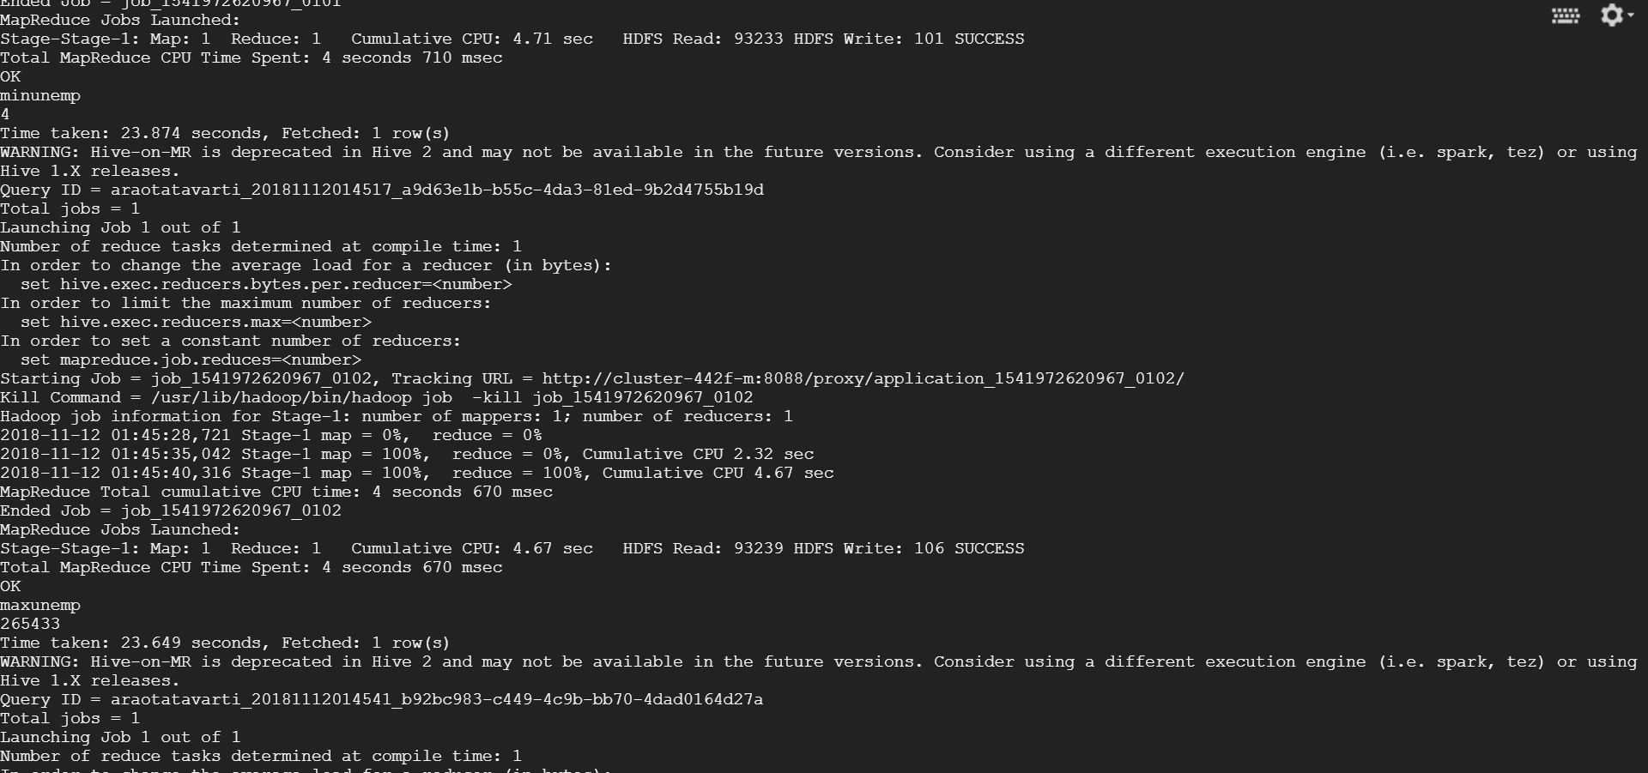
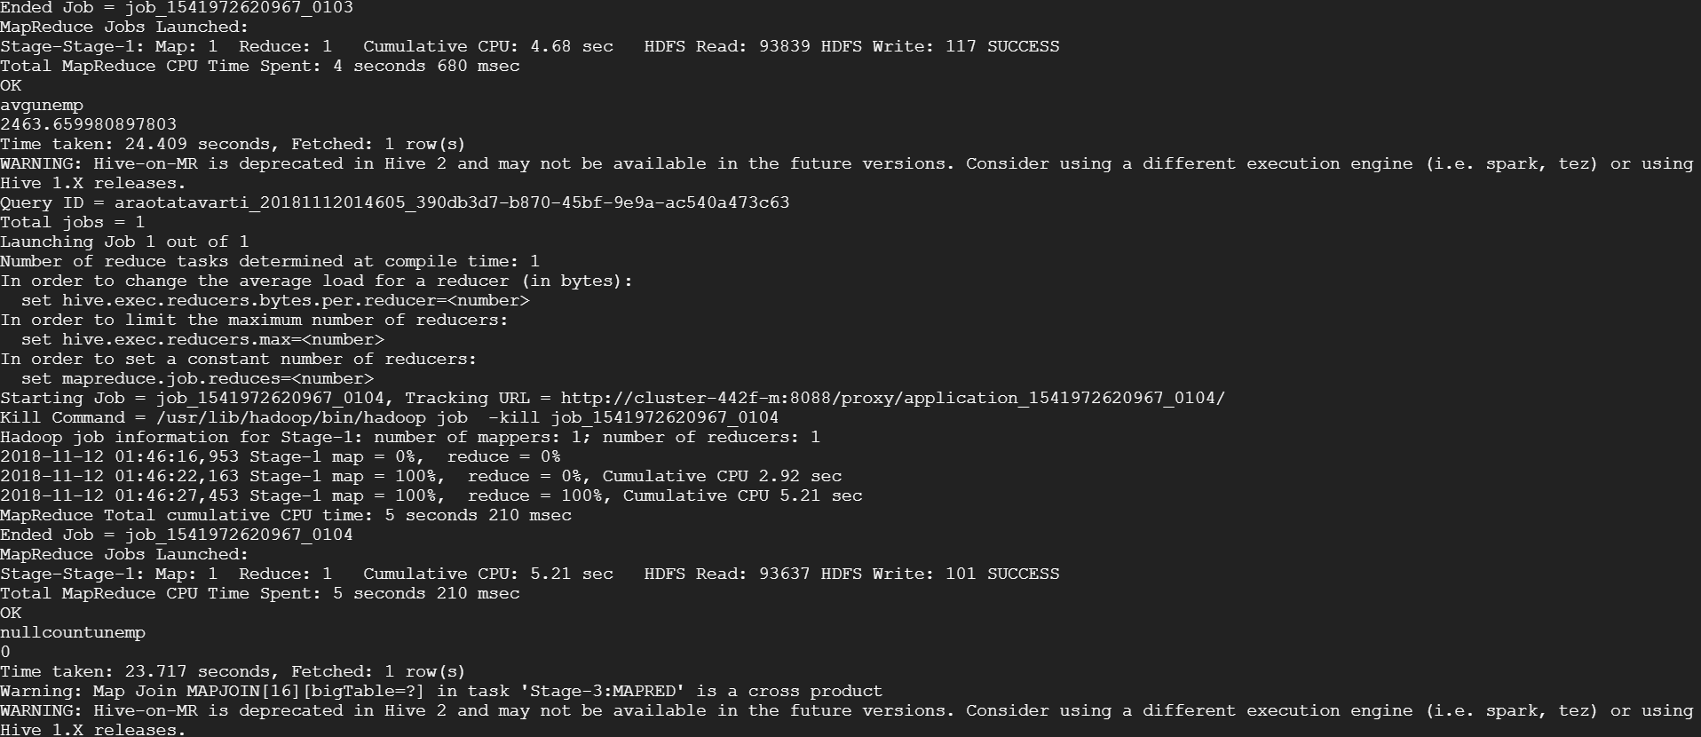
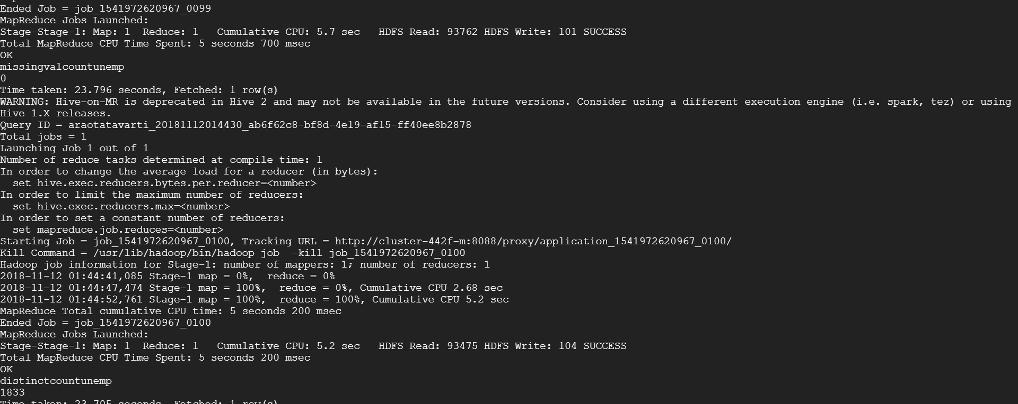
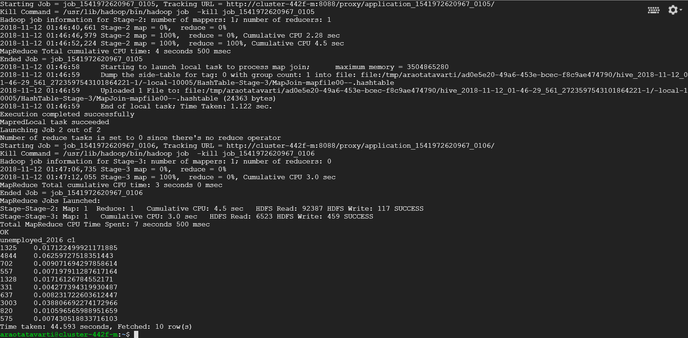
variable: Unemployed_2016 min: 4 , max: 265433 avg: 2463.6599, nulls: 0 missing values: 0, distinct values: 1833

Slide 20
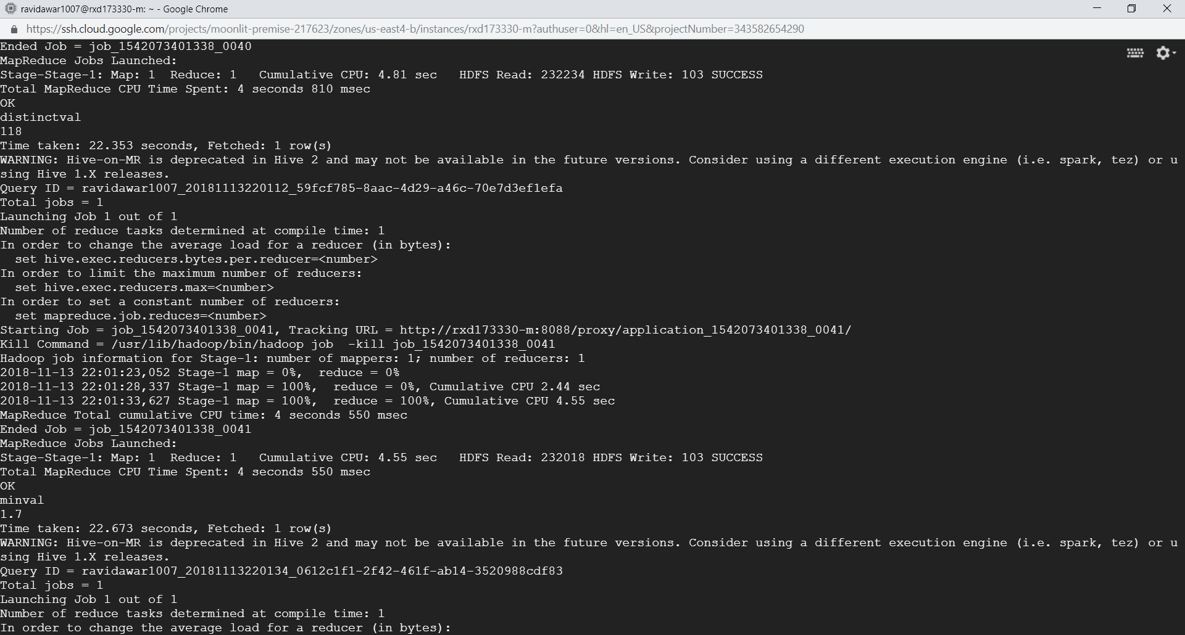
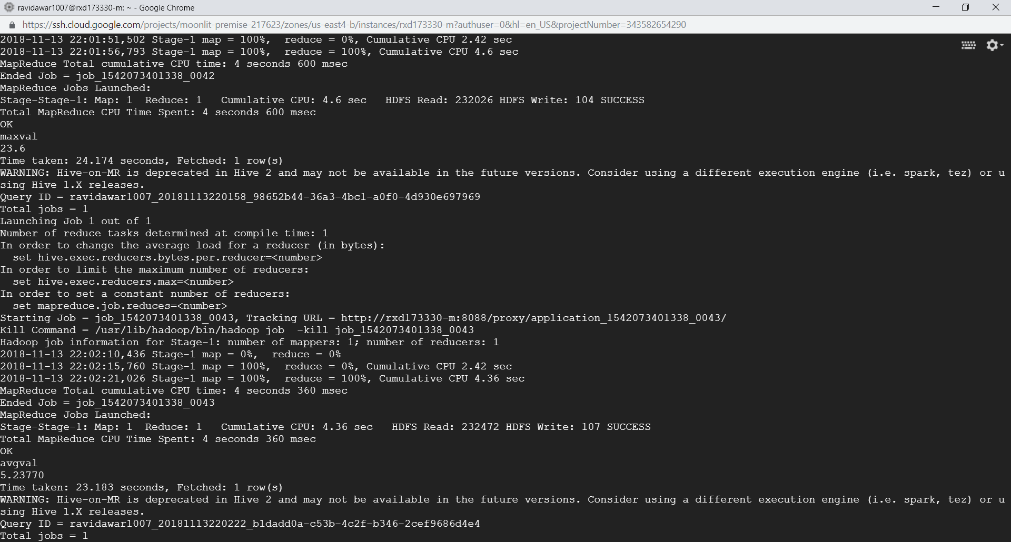
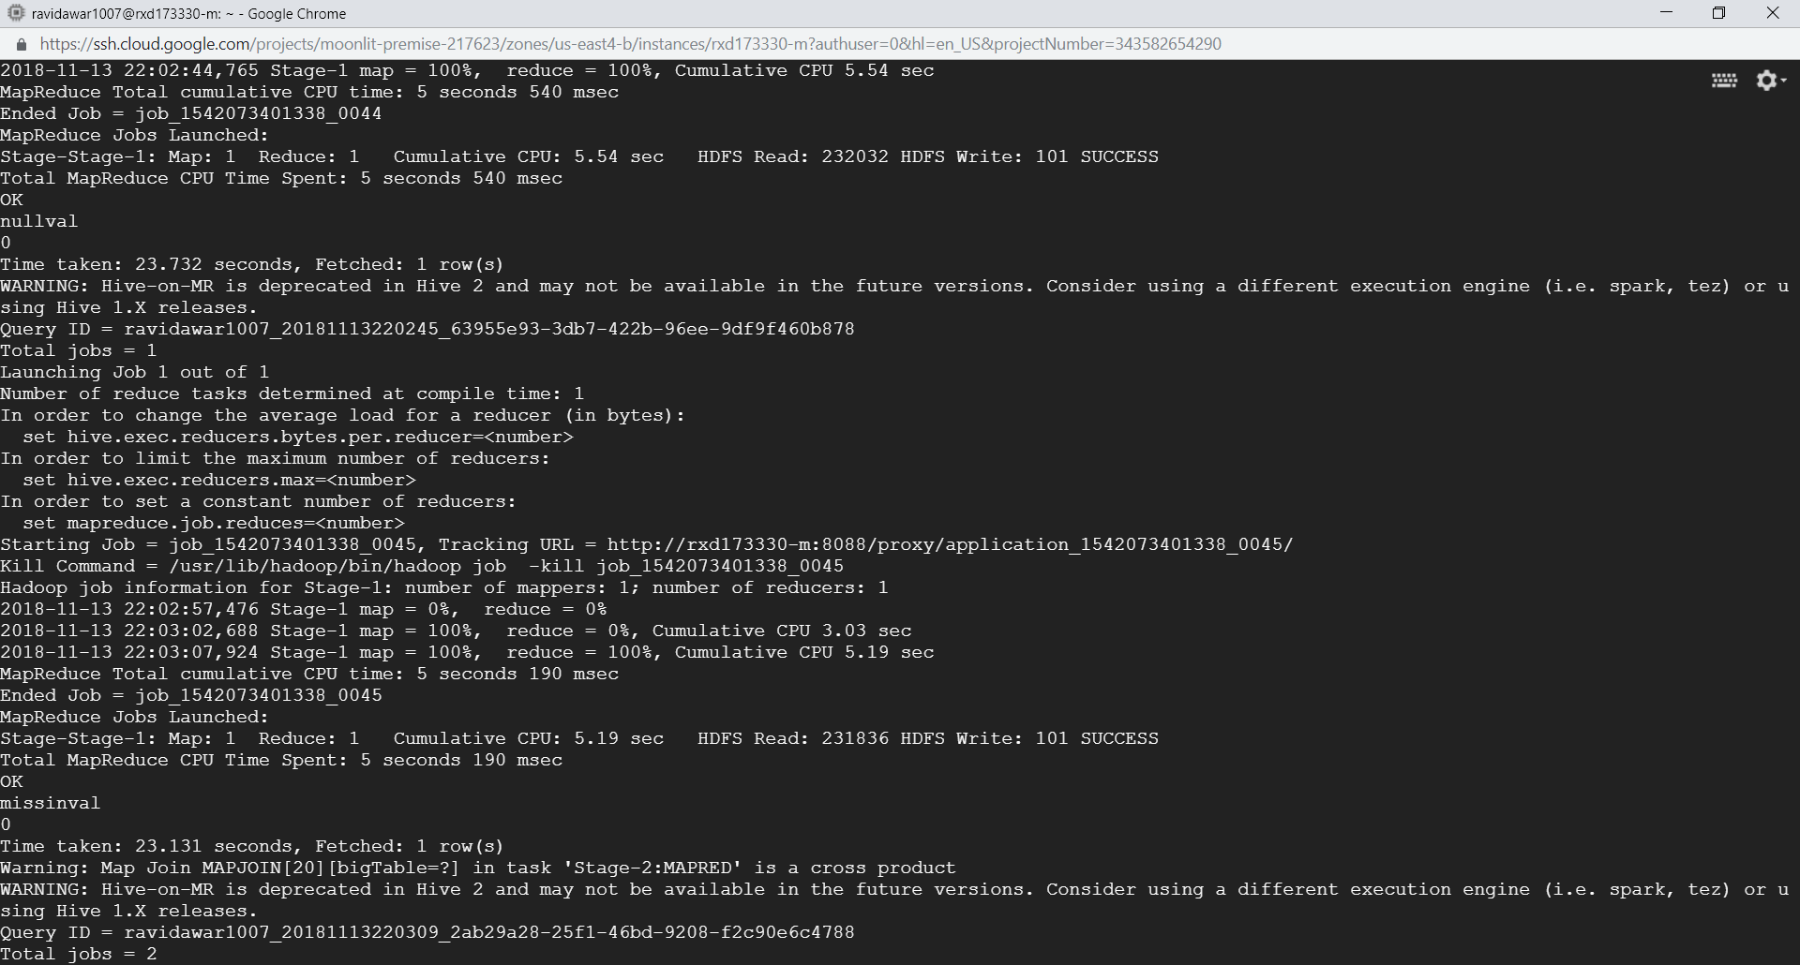
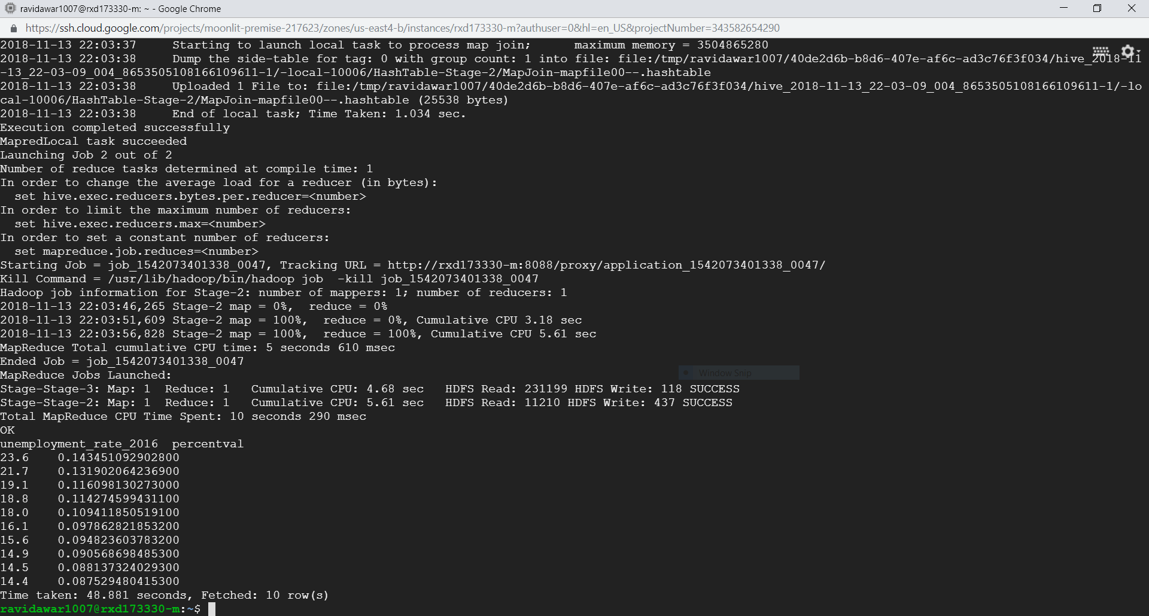
variable: Unemployment_rate_2016 min: 1.7 , max: 23.6 avg: 5.23770, nulls: 0 missing values: 0, distinct values: 118

Slide 21
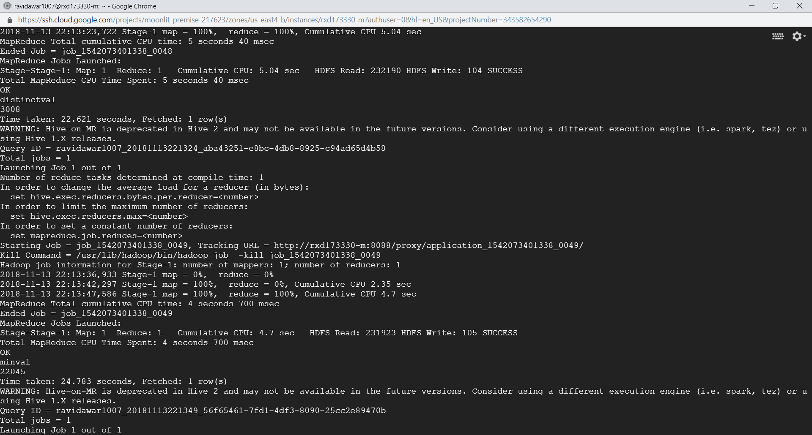
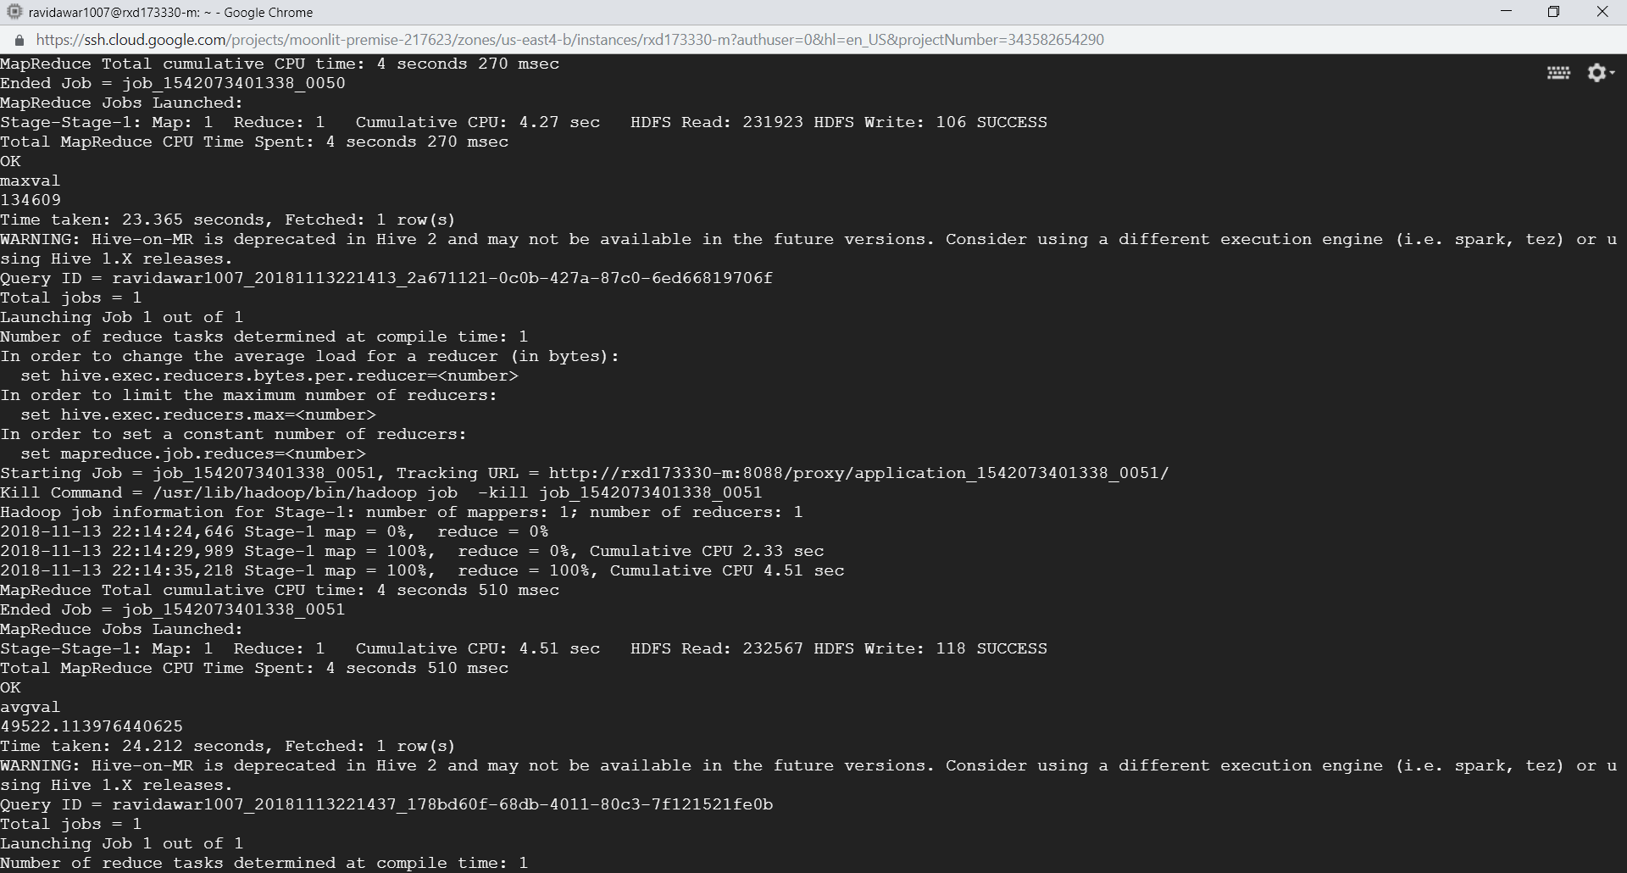
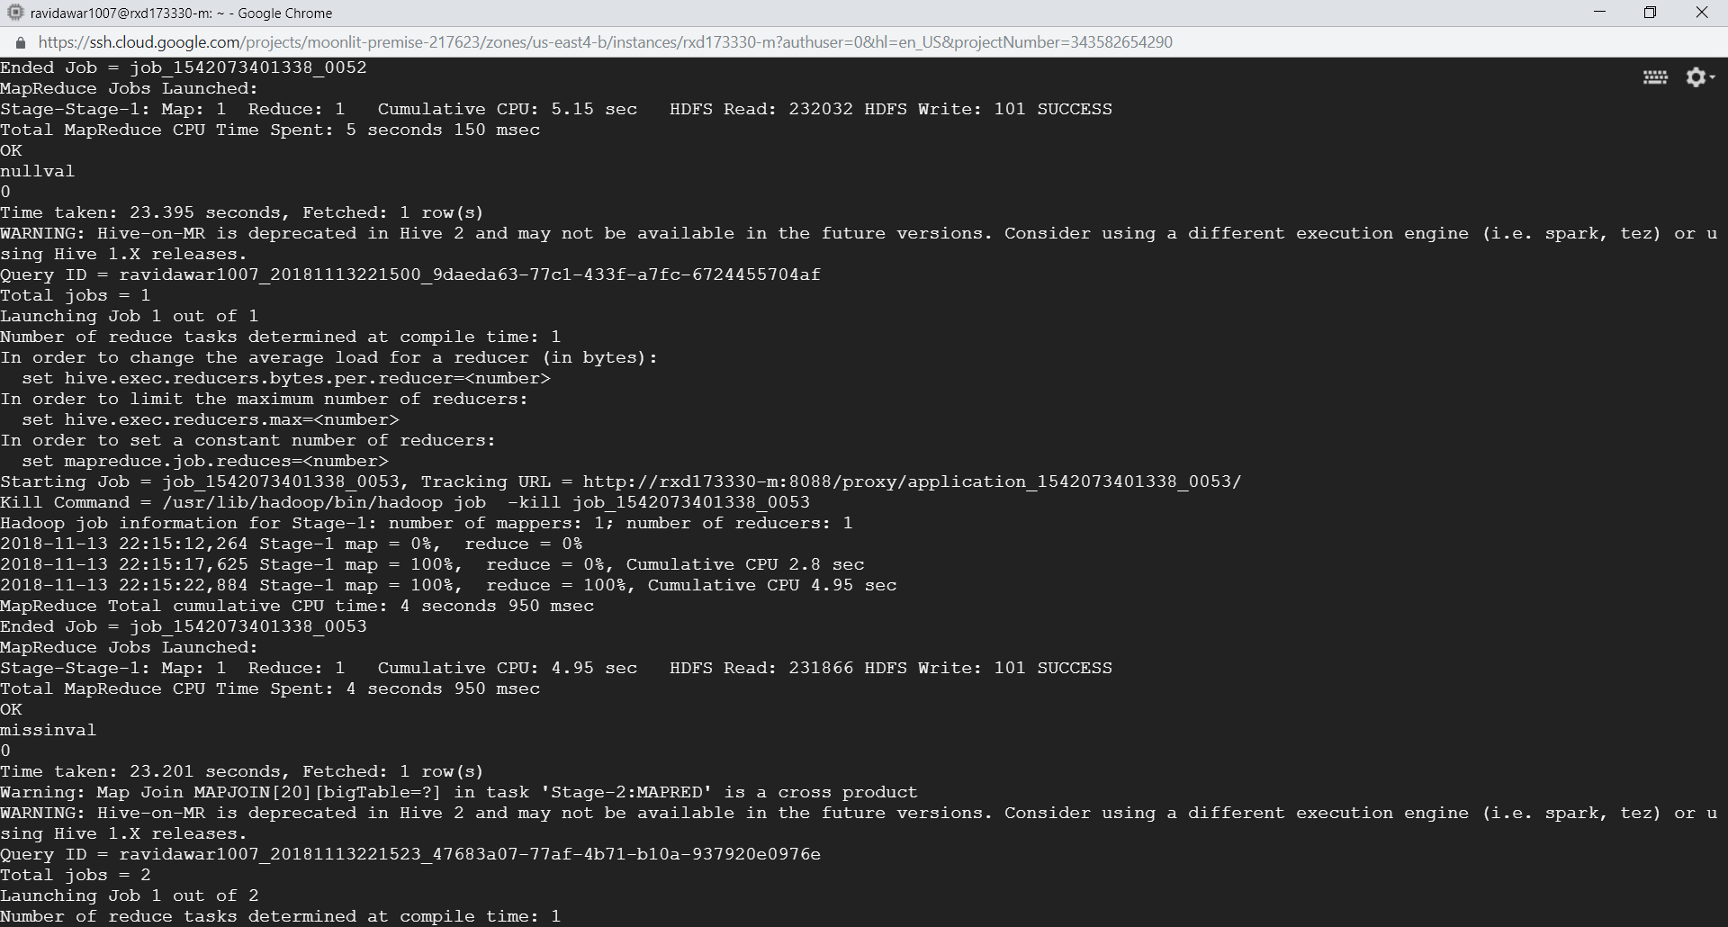
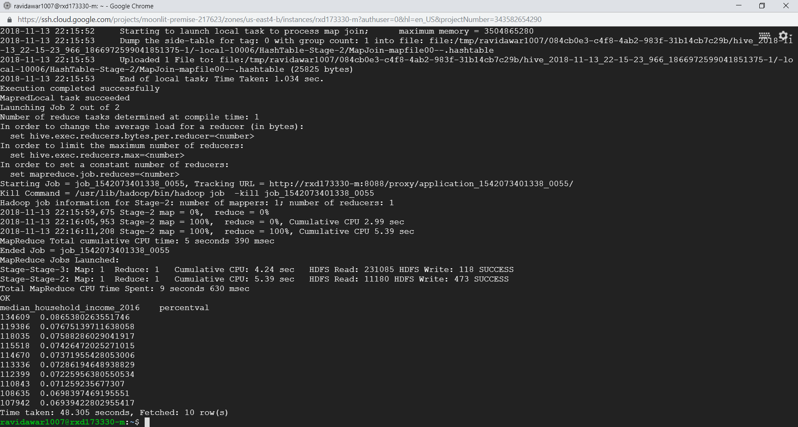
variable: Median_Household_Income_2016 min: 22045 , max: 134609 avg: 49522.11 , nulls: 0 missing values: 0, distinct values: 118

Slide 22
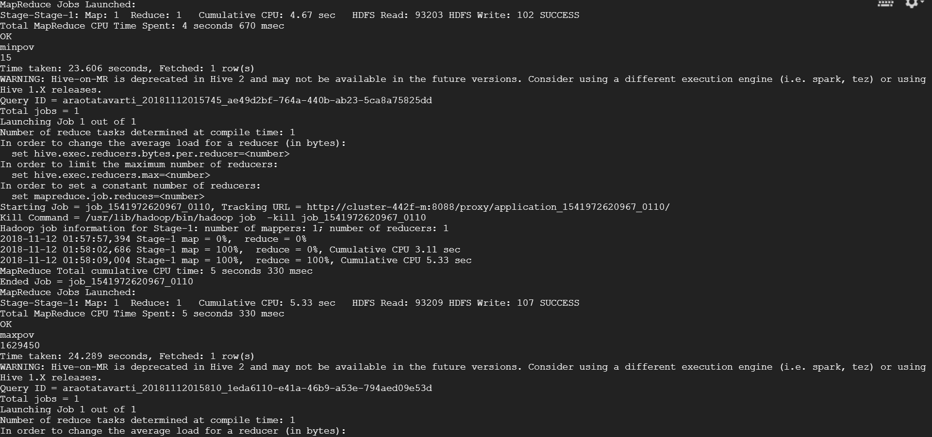
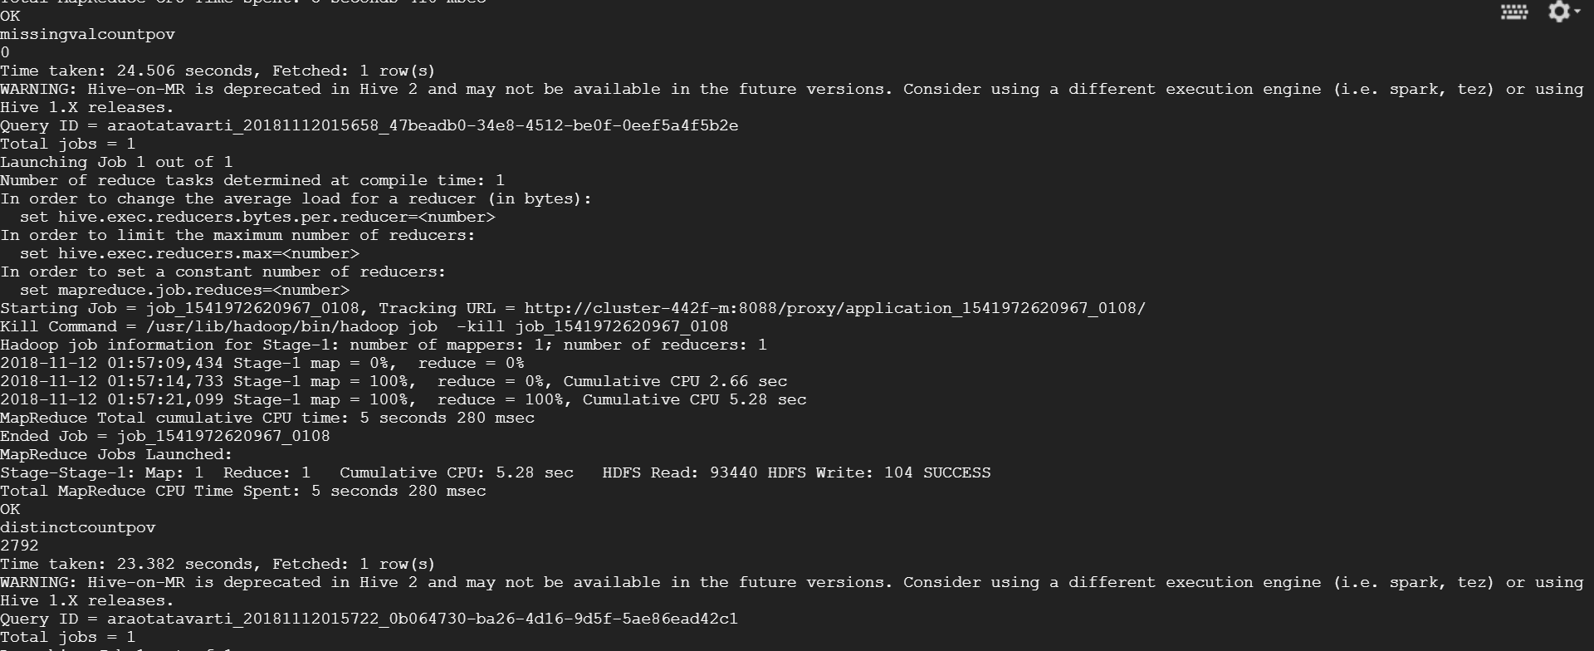
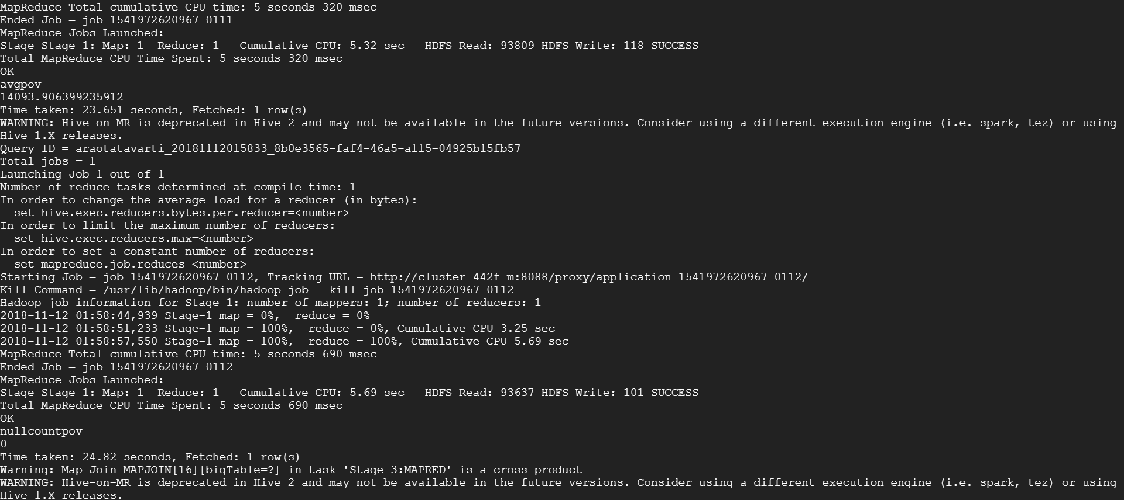
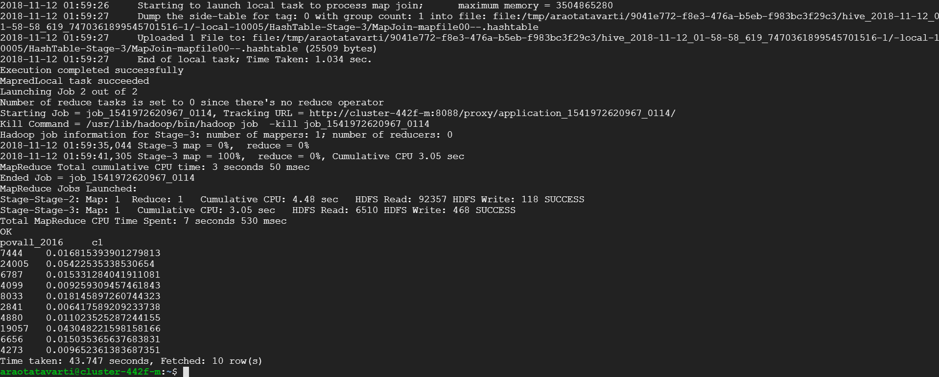
variable: POVALL_2016 min: 15 , max: 1629450 avg: 14093.9063, nulls: 0 missing values: 0, distinct values: 2792

Slide 23
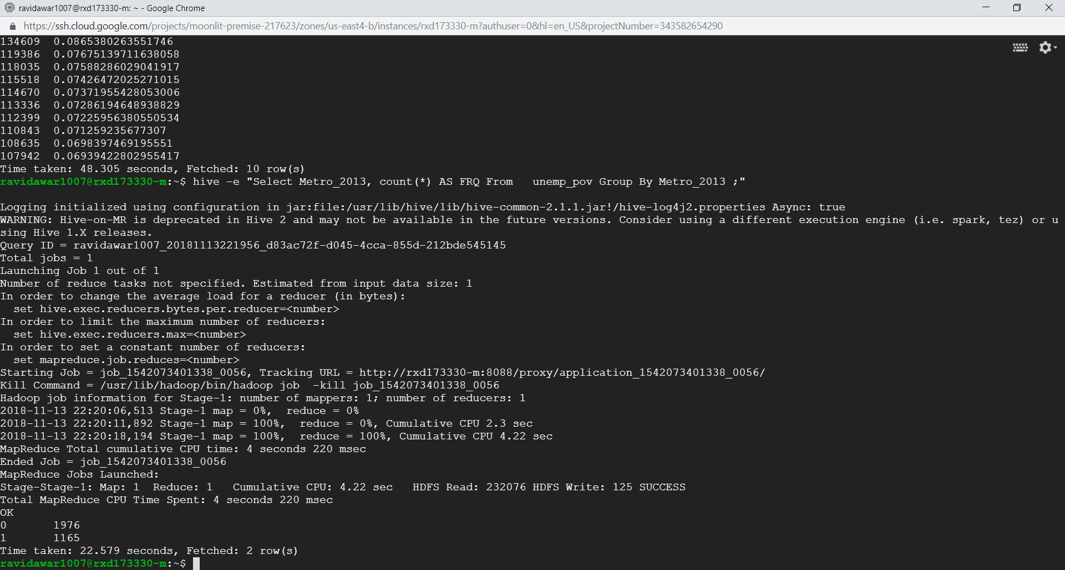
Distribution of Metro and Non- Metro in the Data set
variable: Metro_2013 Metro : 1165
Non-Metro : 1976

Slide 24
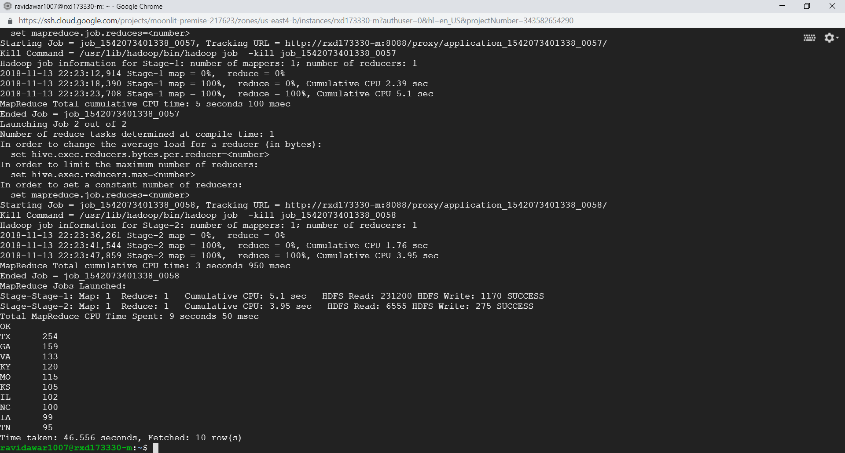
Top Ten States with maximum number of Counties associated with it
State | No. of Counties
TX | 254
GA | 159
VA | 133
KY | 120
MO | 115
KS | 105
IL | 102
NC | 100
IA | 99
TN | 95

Slide 25
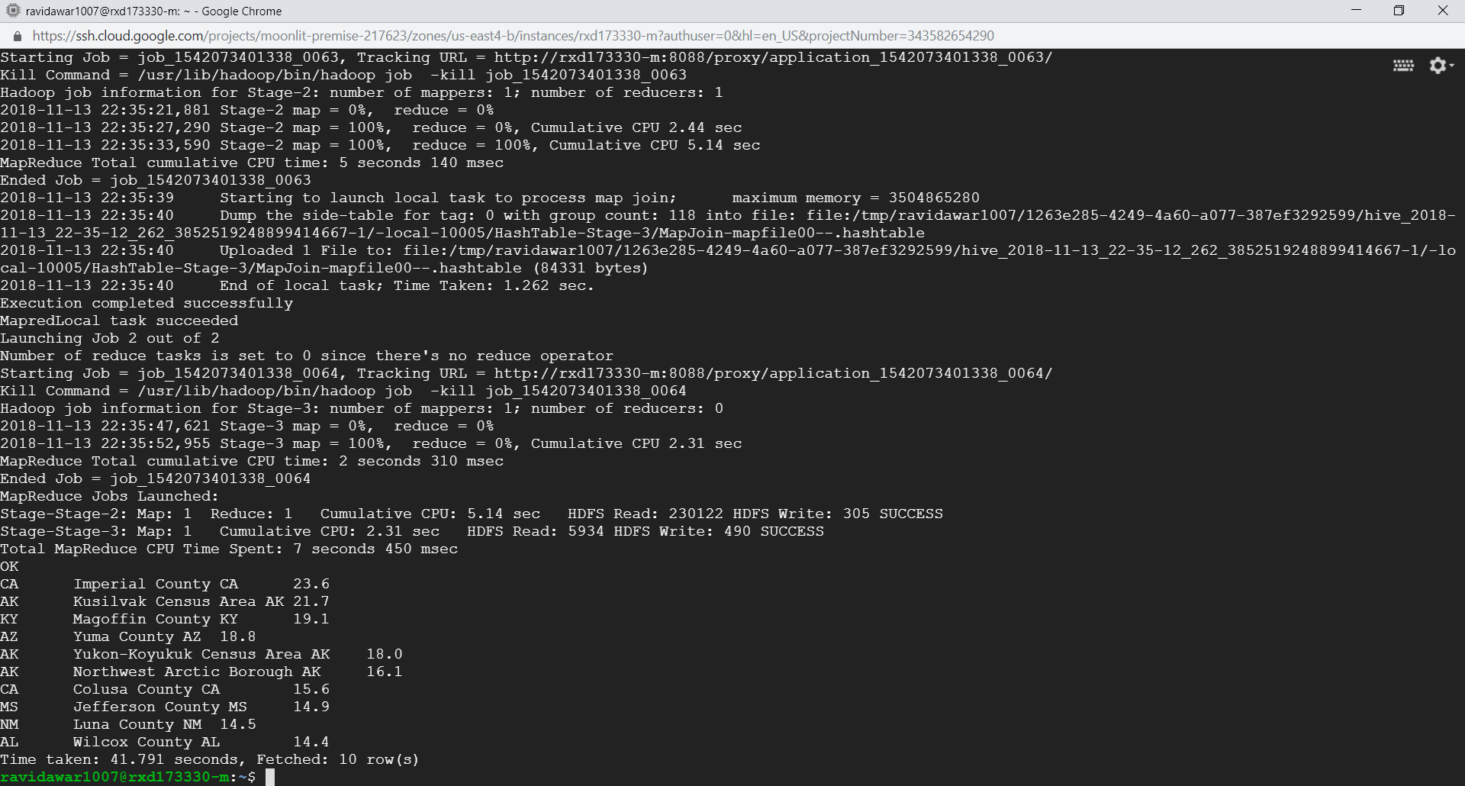
State and its County with Highest level of Unemployment_rate
STATE | COUNTY | Unemployment_rate_2016
CA | IMPERIAL | 23.6
AK | KUSILVAK | 21.7
KY | MAGOFFIN | 19.1
AZ | YUMA | 18.8
AK | YOKUN-KOYUKUK | 18.0
AK | NORTHWEST ARTIC | 16.1
CA | COLUSA | 15.6
MS | JEFFERSON | 14.9
NM | LUNA | 14.5
AL | WILCOX | 14.4

Slide 26
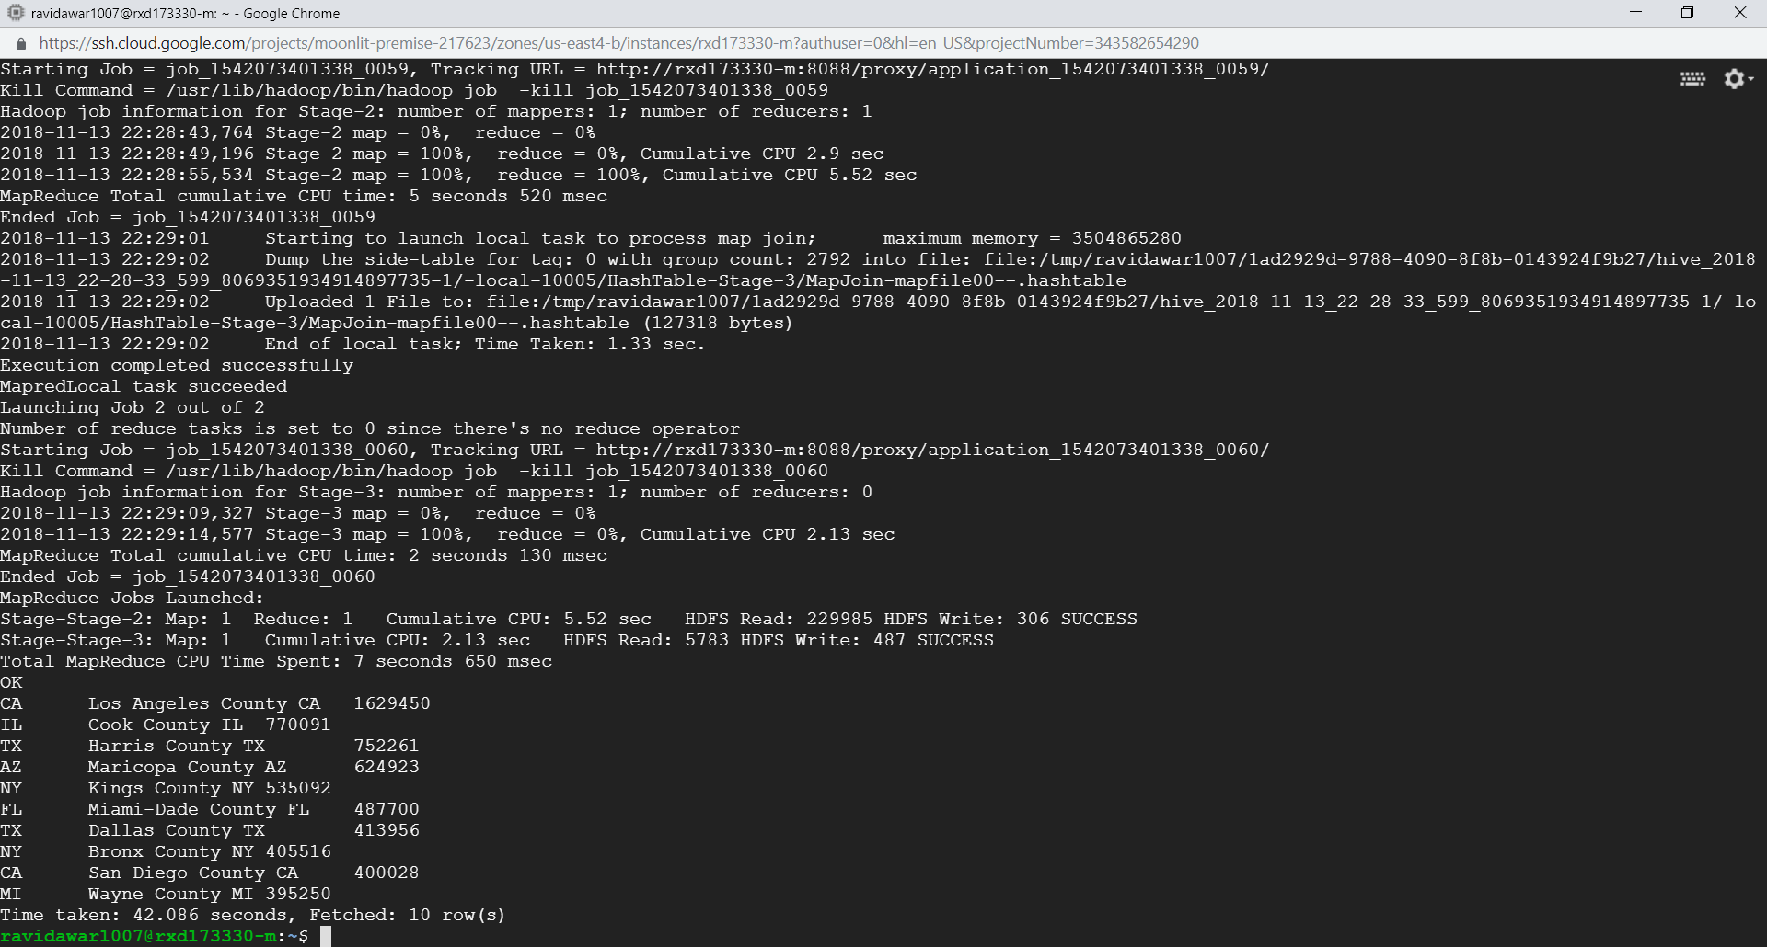
Top TEN States and its counties with Highest level of POVALL_2016(Poverty)
STATE | COUNTY | POVALL_2016
CA | LOS ANGELES | 1629450
IL | COOK | 770091
TX | HARRIS | 752261
AZ | MARICOPA | 624923
NY | KINGS | 535092
FL | MIAMI-DADE | 487700
TX | DALLAS | 413956
NY | BRONX | 405516
CA | SAN DIEGO | 400028
MI | WAYNE | 395250

Slide 27
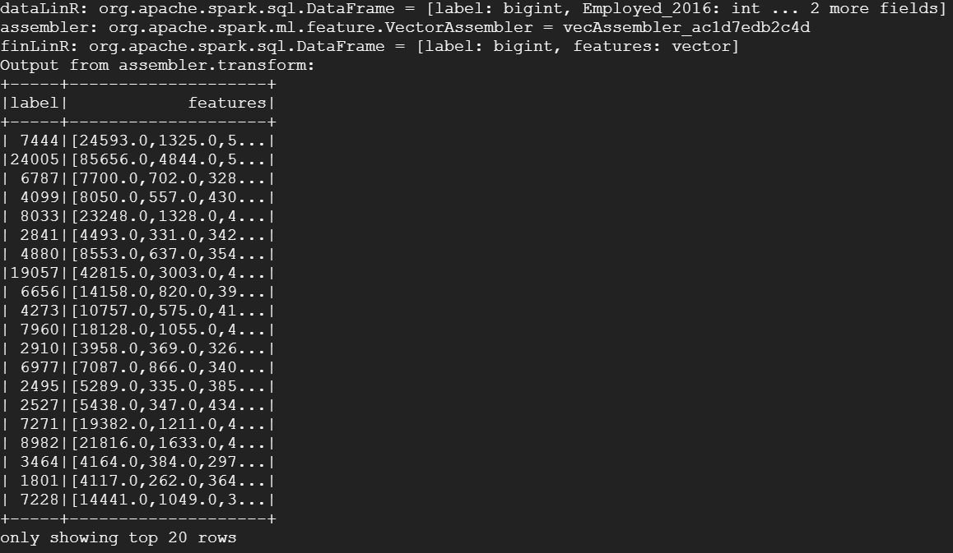
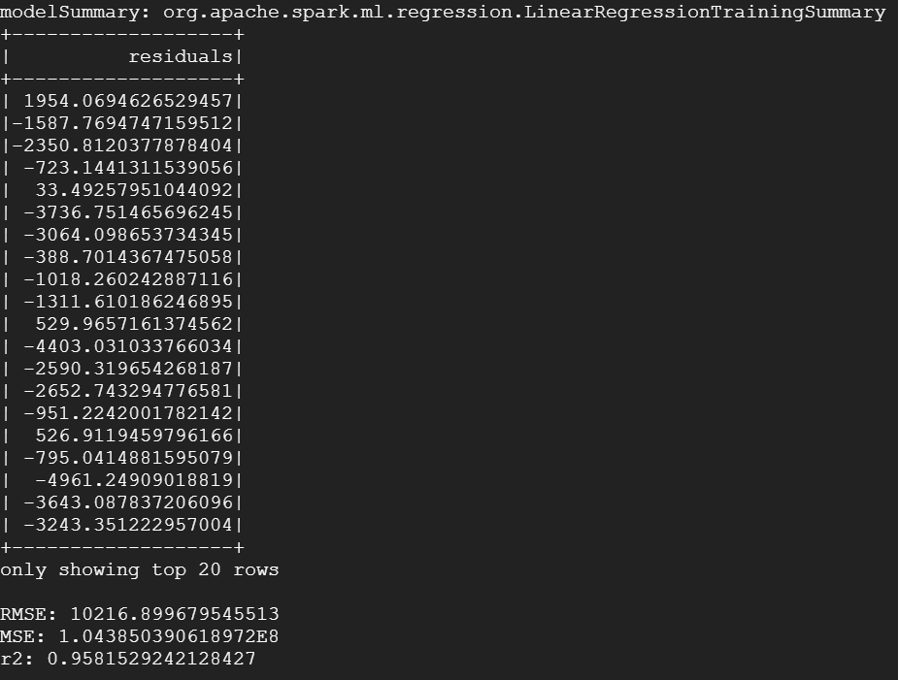
Linear Regression

Slide 28
Details of Model
Linear Regression
We are considering following variable:
Target variable: POVALL_2016 as Label
Dependent Variable: Employed_2016,Unemployed_2016,Median_Household_Income_2016 as features
which we extracted and stored as data frame: ""dataLinR" from table unemp_pov using command
spark.sql("select POVALL_2016 as label,Employed_2016,Unemployed_2016,Median_Household_Income_2016 from unemp_pov ")
Output are
RMSE: 10216.899679545513
MSE: 1.043850390618972E8
r2: 0.9581529242128427
Conclusion : From residual value we can infer from the obtained output values that the model is not accurate as the residuals are of higher magnitude

Slide 29
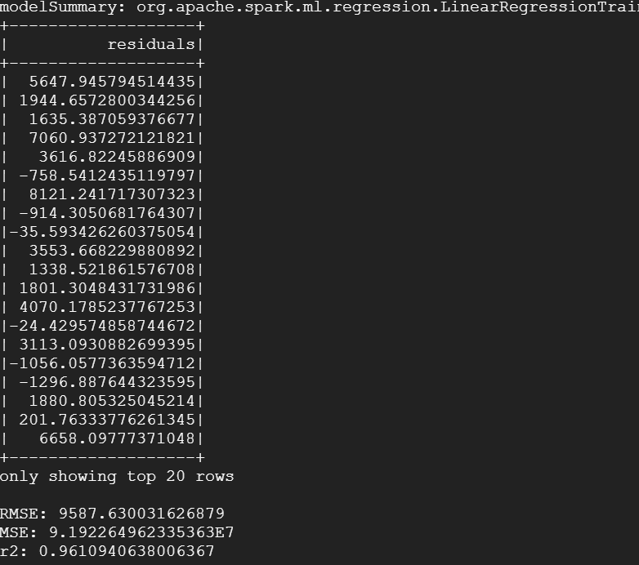
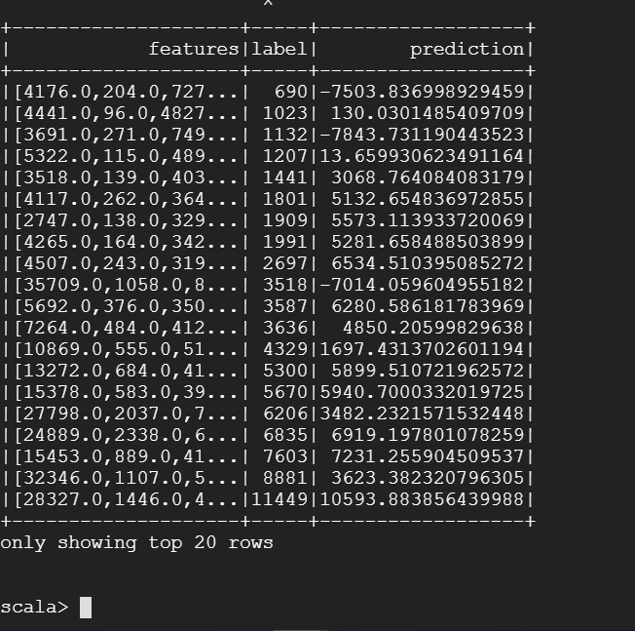
Simple Cross validation

Slide 30
Details of Model
Simple Cross Validation
We are considering following variable:
Target variable: POVALL_2016 as Label
Dependent Variable: Employed_2016,Unemployed_2016,Median_Household_Income_2016 as features
We are creating Train set and Test set the original from the dataframe “dataLinR” created using command
spark.sql("select POVALL_2016_2013 as label,Employed_2016,Unemployed_2016,Median_Household_Income_2016 from unemp_pov ")
Train and Test set are created using: val Array(training, test) = finLinR.randomSplit(Array(0.9, 0.1), seed = 2018)
with random seed set to 2018 and finLinR is the dataframe created after the Vector assembler transformation.
Output
For Train set
RMSE: 10216.899679545513 , MSE: 1.043850390618972E8, r2: 0.958152924212842
For Test Set
Table Representing the Features, Actual Label and the Prediction based on the Train set.
Conclusion : We can infer from the table that the values predicted are under fit and the model is not efficient.

Slide 31
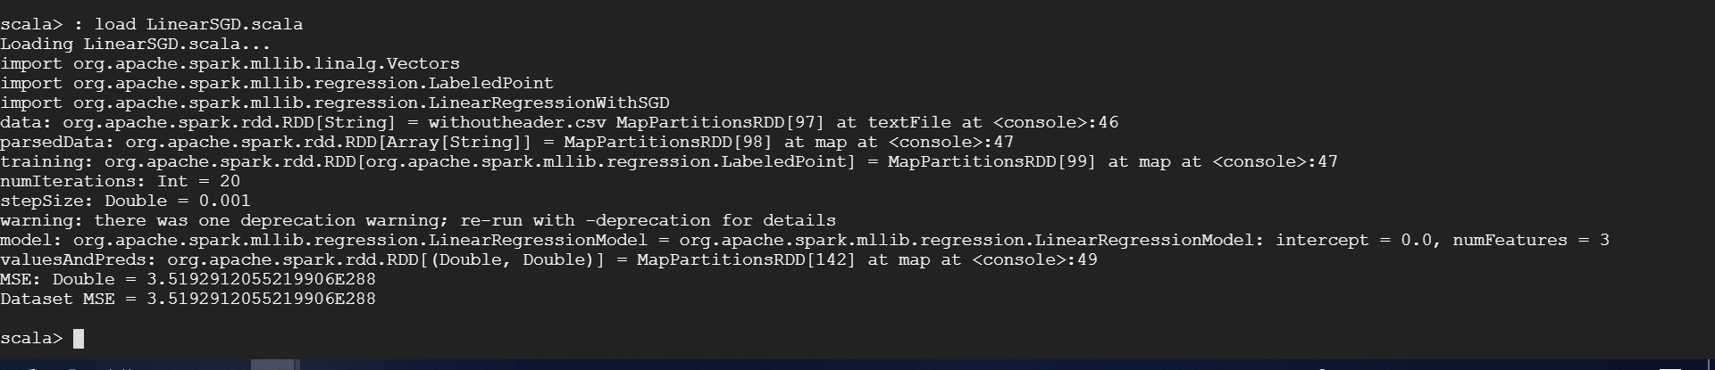
Linear SGD
Note: Before running the LinearSGD.scala file, make sure the dataset file is in Hive “/user/username/”

Slide 32
Details of Model
Linear Stochastic Gradient Descent
We are considering the following variable:
Target variable: POVALL_2016 as Label
Dependent Variable: Employed_2016,Unemployed_2016,Median_Household_Income_2016 as features
which we extracted and stored as parsedData from the dataset file ”wihtoutheader.csv” stored in hive in location “/user/username/” and converting in to LabeledPoint (label , features)
Defined Parameter for the LinearRegressionWithSGD
Number of iteration as : “numIterations” = 20
Learning Rate as “Stepsize” = 0.001
Output:
MSE value
MSE: 3.5192912055219906E28
Conclusion : We can infer from the Mean squared error obtained after Applying the LinearSGD regressor that
The MSE is close to Zero, which means the models predict the value with less magnitude of residual errors ,which can be considered as better model over other models used to predict the labels

Slide 33
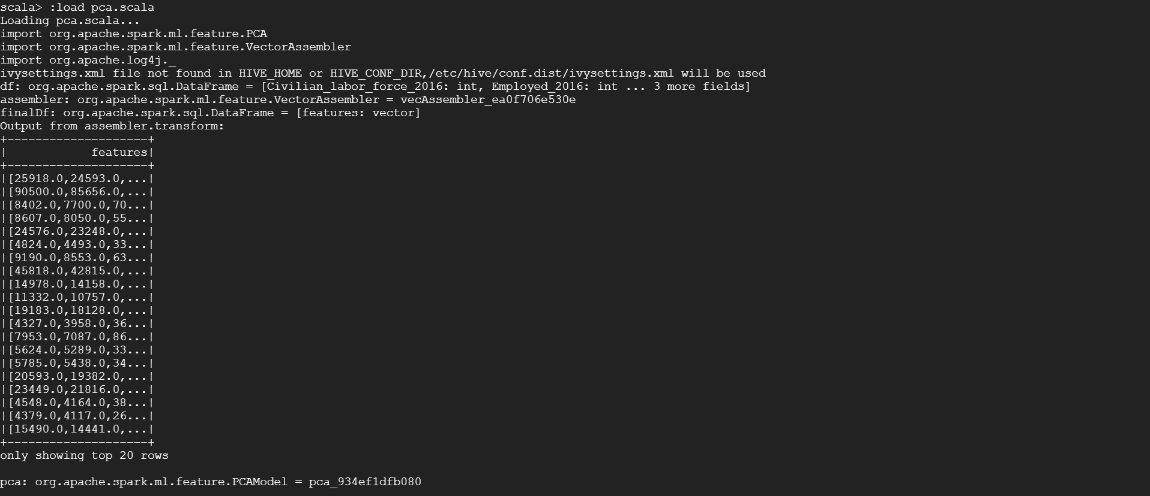
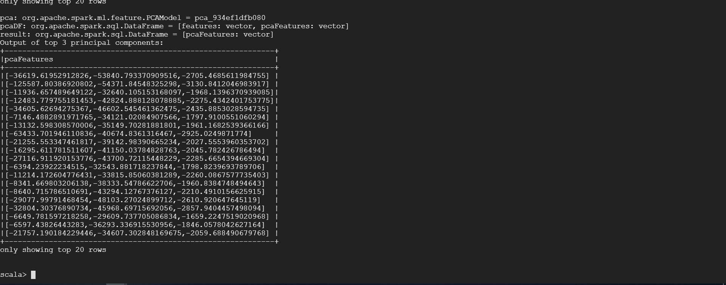
Principal Component Analysis

Slide 34
Details of Model
Principal Component analysis
Implementing PCA which is a dimensionality reduction method which can help in getting the features which captures maximum variance in the dataset with minimum features.
Dependent Variable: Civilian_labor_force_2016, Employed_2016, Unemployed_2016, Unemployment_rate_2016, Median_Household_Income_2016 as features
Principal Component to be considered is 3
Output:
PCA Features transformed after considering Principal Component as 3

Slide 35
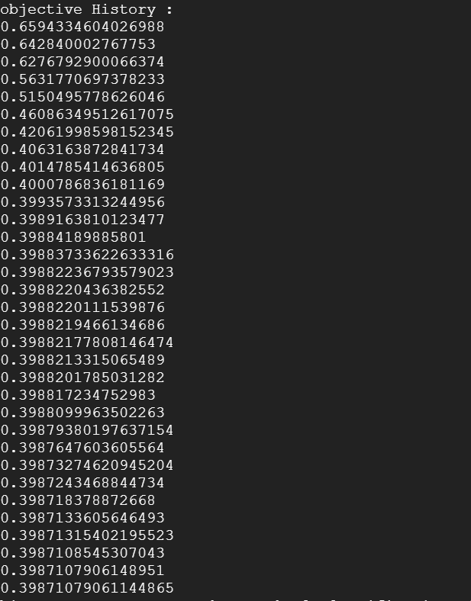
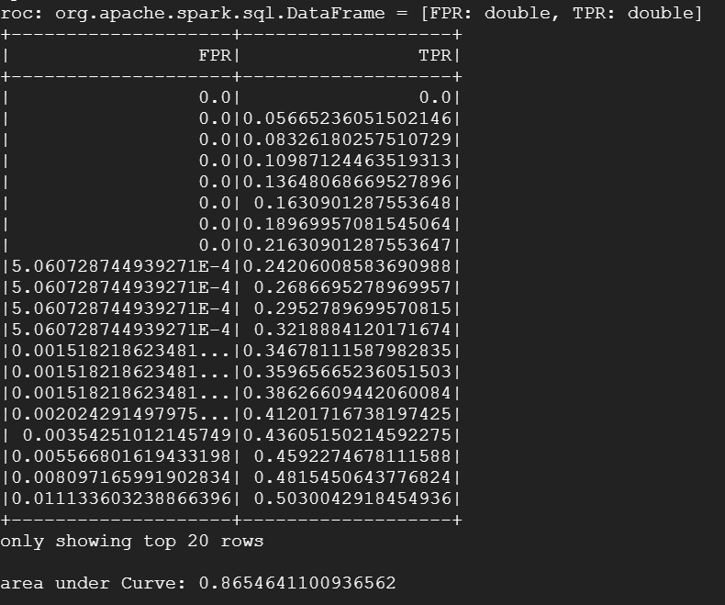
Logistic Regression

Slide 36
Details of Model
Logistic Regression
We are considering following variables:
Target variable: Metro_2013 as Label ( value 0 or 1)
Dependent Variable: Employed_2016,Unemployed_2016,Median_Household_Income_2016 as features
which we extracted and stored as data frame: "" dataLogR" from table unemp_pov using command
spark.sql("select Metro_2013 as label,Employed_2016,Unemployed_2016,Median_Household_Income_2016 from unemp_pov ")
Output:
FPR and TPR table
Area under Curve_ROC
Conclusion: We can infer from the obtained table FPR TPR and area under curve_roc
Value area under Curve: 0.8652768848499592
That the model predicts the Labels with efficiency but is not accurate

Slide 37
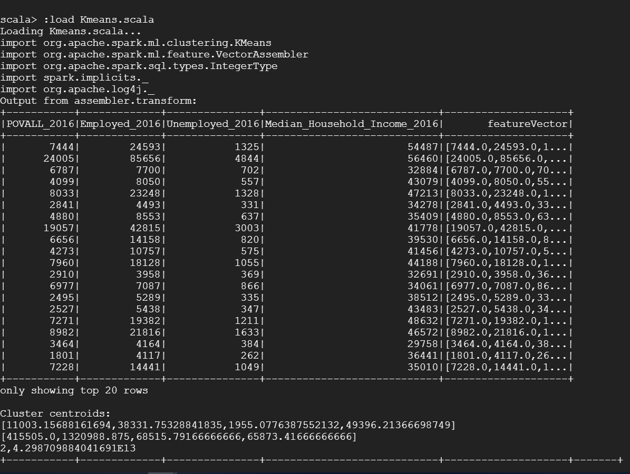
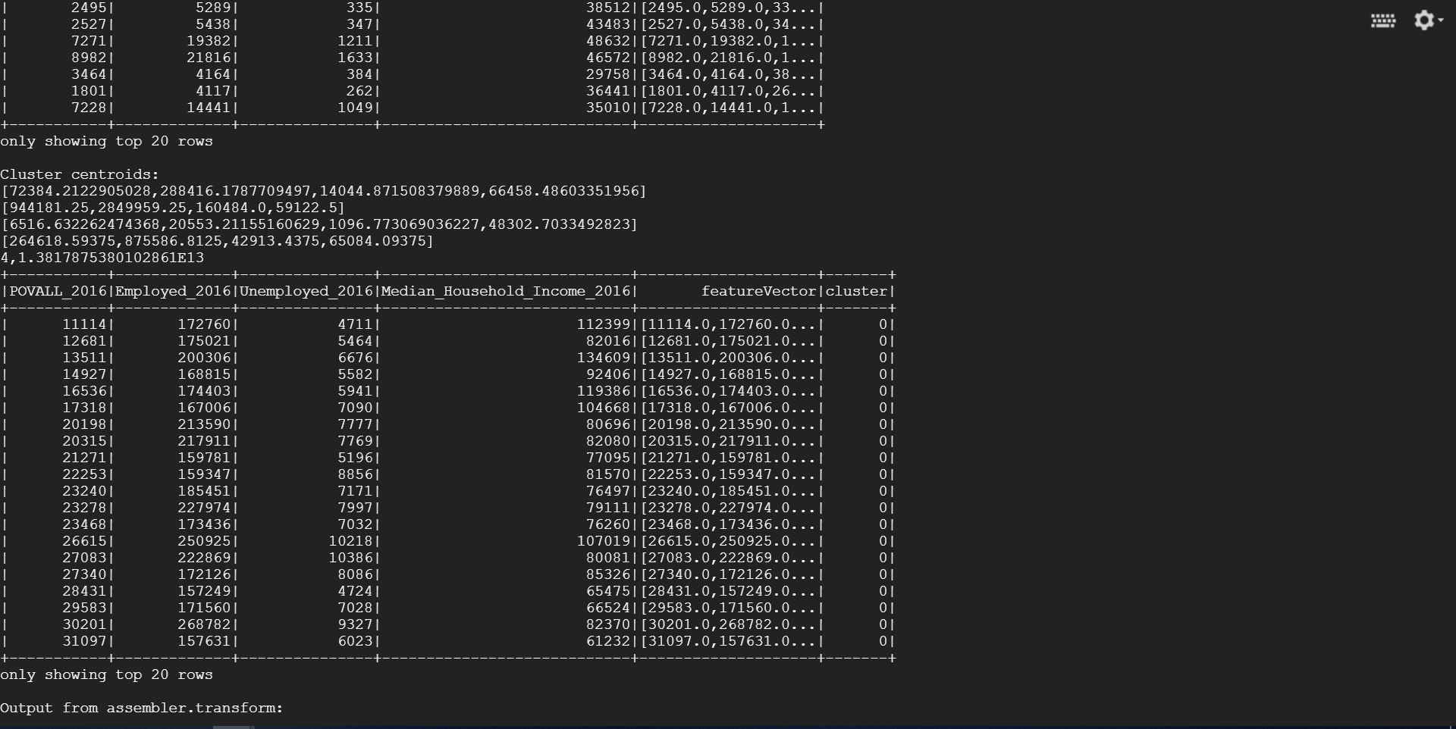
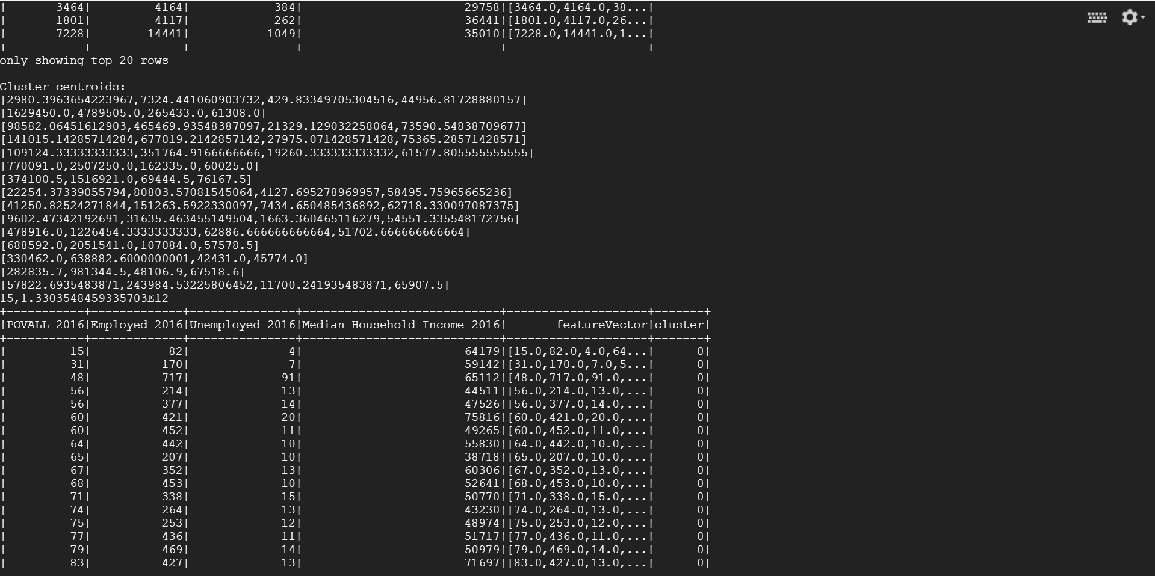
Kmeans Clustering

Slide 38
Details of Model
Kmeans Clustering
We are considering Unsupervised learning method to cluster the instances in our dataset on the basis of the similarity among them.
Feature Vector or Variables considered : POVALL_2016,Employed_2016,Unemployed_2016,Median_Household_Income_2016
Value of K = In range 2 to 15
Output:
Cluster centroids: Centroids considered for every K values from the data set
Number of Clusters (K) and Compute cost for each value of K
Kmeans model prediction summary for each value of K
Conclusion: From the obtained outputs and comparing the compute cost for each value of K.
We can consider that number of cluster (K = 4) can very well cluster instances in our data set.
With less compute cost and also as the value of K increases there is not much changes in the compute cost value .

Slide 39


